Slide 1
Crowdfunding for Beginners
June 28, 2023

Slide 2
Topics Overview
Introduction to Crowdfunding
Crowdfunding Types
Donation Crowdfunding in Detail
Activity for Success
JOBS Act, Title III

Slide 3
Drew Tulchin
New Mexico Angels - President

Slide 4
Thanks event sponsors & speakers!

Slide 5
New Mexico Angels Mission
We are a 501c6 non-profit membership organization (ala chamber of commerce) with a 501c3 fiscal sponsorship
We focus on NM companies, New Mexican entrepreneurs and products that can make a difference for our people

Slide 6
New Mexico Angels 2023 Q2-Impact
$480K Invested in 7 companies NM Angels, NM Vintage Fund & Members
$1million+ leveraged
34+ Companies reviewed, assessed and mentored
16 New Angels trained

Slide 7
NM Angels - Who We Are
NM Angels About Us Page
Tripled in 2 years!
 | Members | Sponsors
COVID | 28 | 12
2021 | 89 | 24
2022 | 115 | 32
2023 | 127 | 36

Slide 8
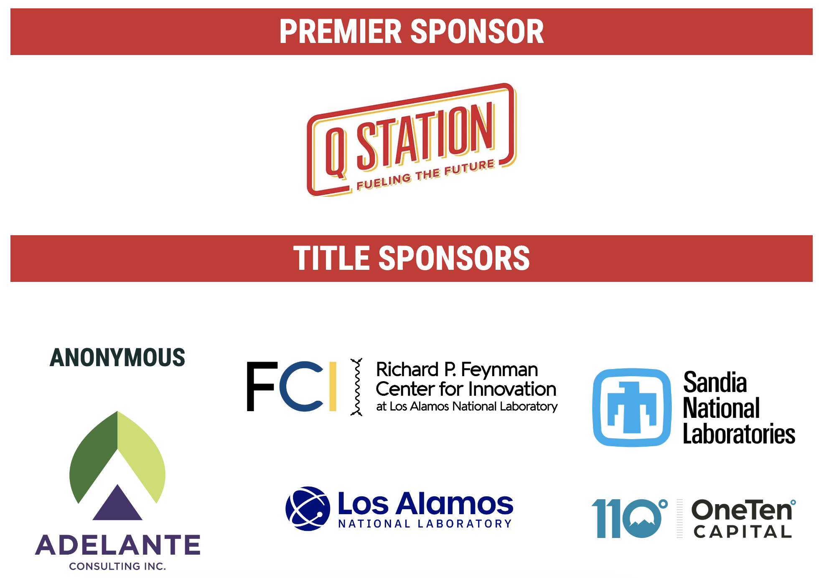

Slide 9
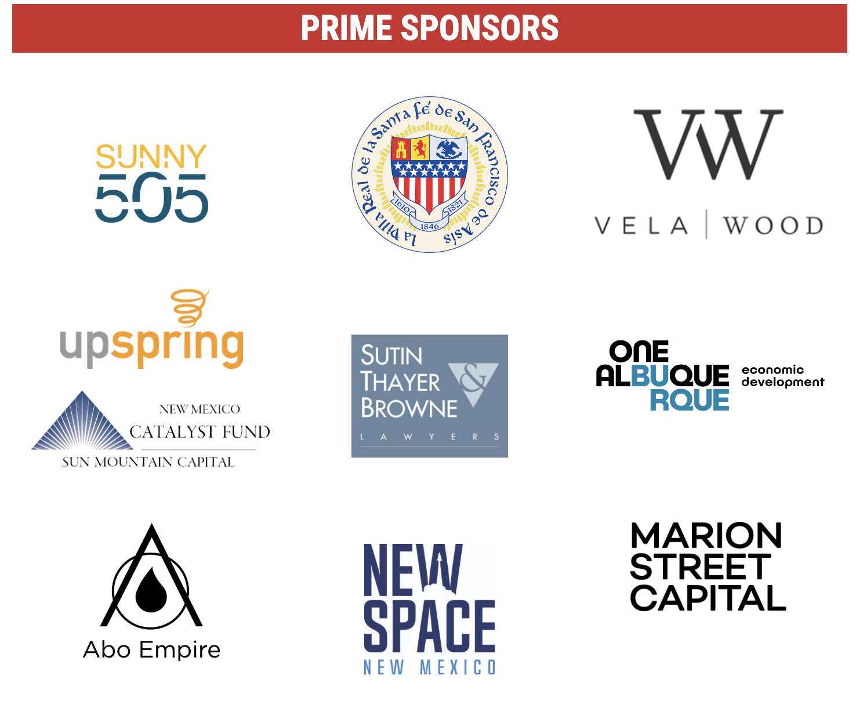

Slide 10
Become an Angel!
Membership
Sponsorship
Entry to NM Angels events (in-person and online)
Monthly NM meetings, Rockies Venture Club (RVC) access, annual conference
Educational seminars
Membership to national ACA
Position your biz as a leading investment partner in NM
Promotion on NM Angels’ website, at events
Reach our community / Referrals
Early access to current deals

Slide 11
New Mexico Vintage Fund
New Mexico Vintage Fund (NMVF) invests in early-stage and high growth local companies,
New Mexican entrepreneurs, and entities whose products / services will benefit our people.
Generalist fund offers broad-based diversification by industry sector, company age, investing vehicle
Brings together the New Mexico investing community - in funds formed each year, like a vine vintage

Slide 12
Next Events
New Mexico Angels Events | Ecosystem Events
Manufacturing Tour: Build with Robots Thursday July 13th, 5:00PM - 7:00PM | AllerPops Albuquerque Opening Wednesday July 12th, 5PM - 8PM
New Mexico Angels Quarterly Event | Santa Fe Thursday July 20th, 5:30PM - 7:30PM | LANL Lab Showcase & Demo Monday July 17th, 8:30AM - 6PM
Drop-In Mentoring For Entrepreneurs Friday July 21st, 1:00PM - 3:00PM | Santa Fe Business Resource Fair Friday June 30th, 9:00AM - 12:00PM

Slide 13
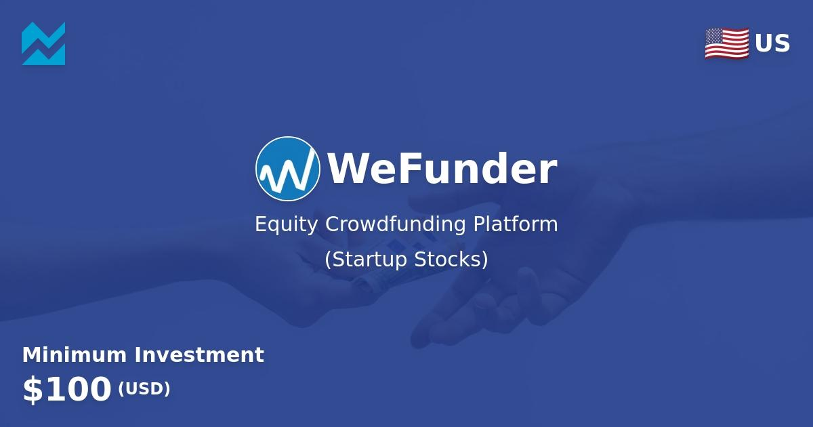
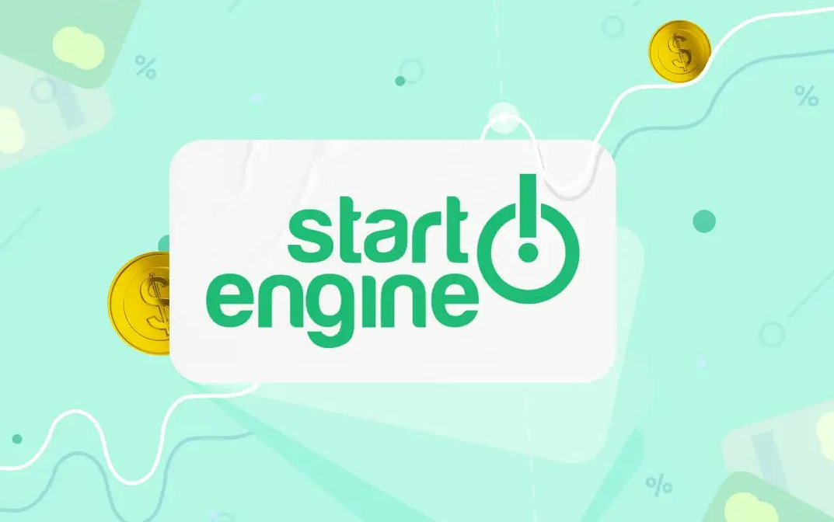
NM Angels & Crowdfunding
Collaborations with each of
WeFunder & StartEngine
Enables us to tap into a vast network of experienced investors and entrepreneurs who are passionate about supporting innovative businesses
Contact info@nmangels.com for Crowdfunding Referral Code
Learn more here

Slide 14
Crowdfunding Defined
Raising money for a project from a large number of people in small amounts, typically online

Slide 15
Traditional Forms of Capital

Slide 16
Crowdfunding Focus
Small biz seeking small amounts of capital, lacking easy access
Early stage organizations & individuals with specific project or product
Opportunity to conduct product pre-sales to finance manufacturing/creation
Who for?
Why do it?
Capital Raising
Media Exposure
Partnership Recruitment
Mindshare, Thought Leadership

Slide 17
Benefits of Crowdfunding
Expands capital raising universe
PR / exposure
Engage new partnerships / opportunities
Opportunity to pre-sell, test the market

Slide 18
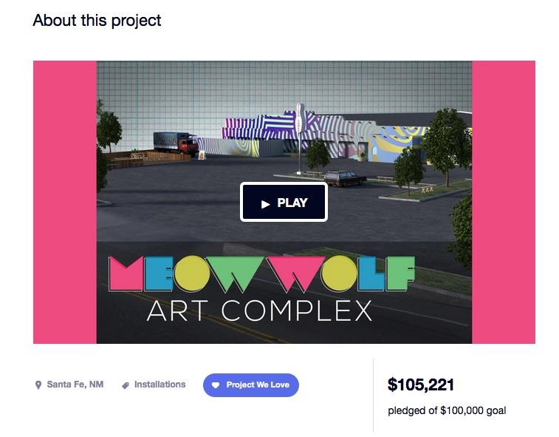
Crowdfunding Leverages the Power of Social Networks

Slide 19
Crowdfunding Types
Donations
Equity
Peer to Peer Lending
Crowdsourcing

Slide 20
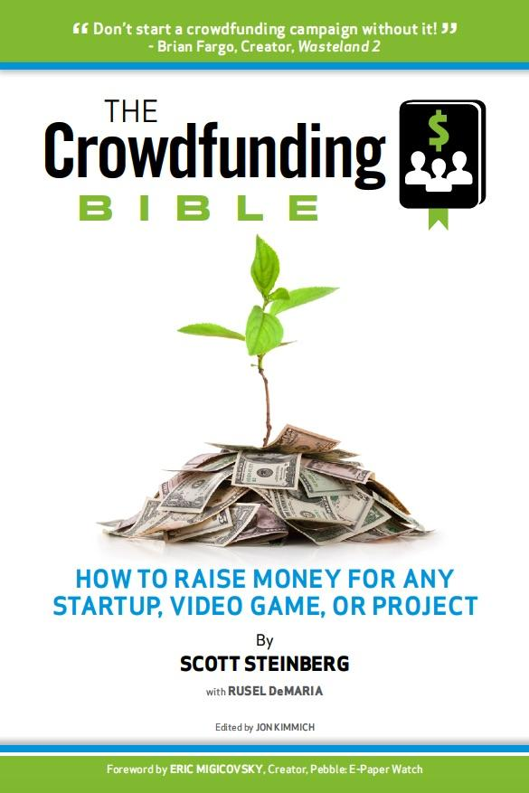
Activity for Success
Read: The Crowdfunding Bible www.crowdfundingguides.com
Honest Answers:
How good is your idea? What value does it offer? How is it different?
Have you done the calculations so you know how much money you need – really?

Slide 21
Activity
Dig deeper - Reach further
What is the hook for your story?
Who is your ‘target market’ (your peeps)
Leverage your Network? What social media sites?

Slide 22
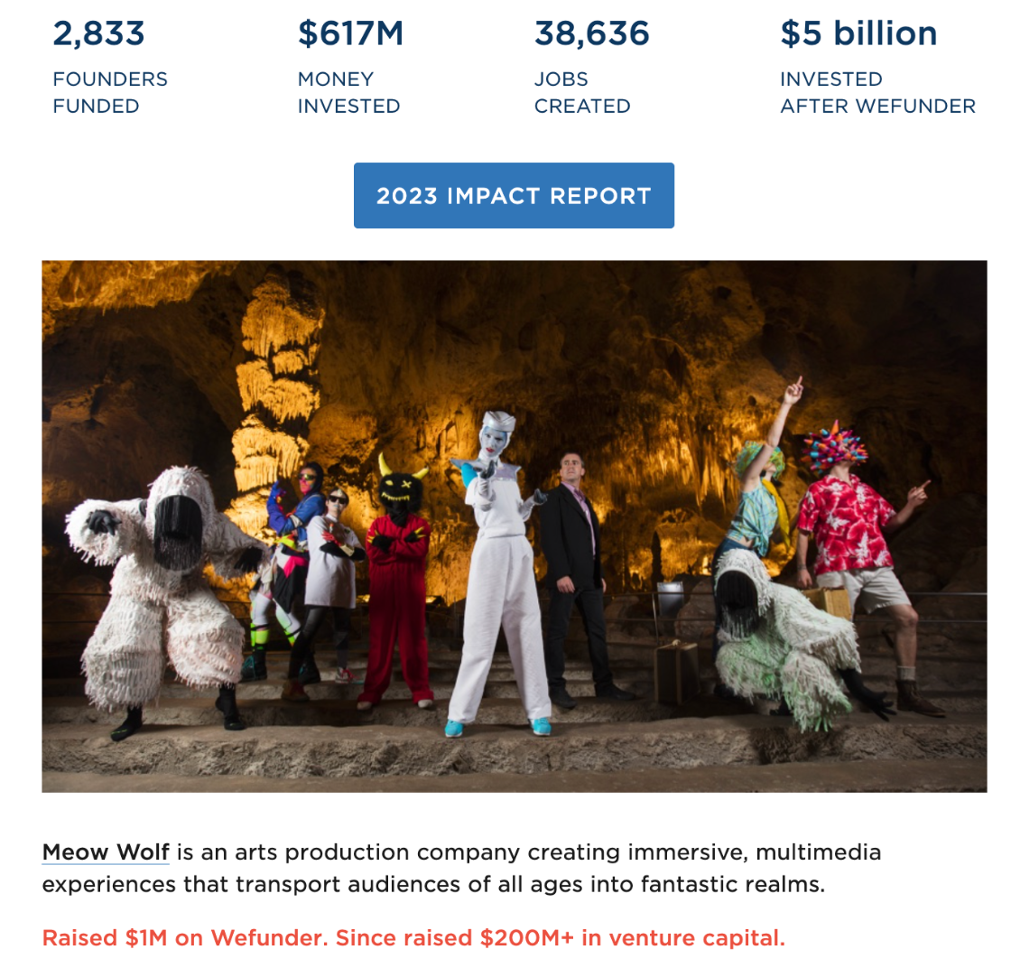
Meow Wolf Case Study

Slide 23
Electric Playhouse Case Study

Slide 24
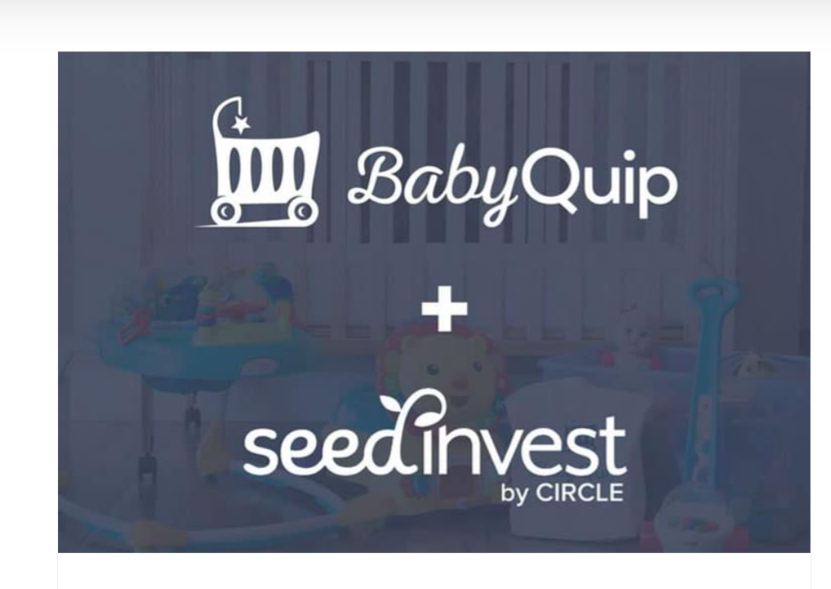
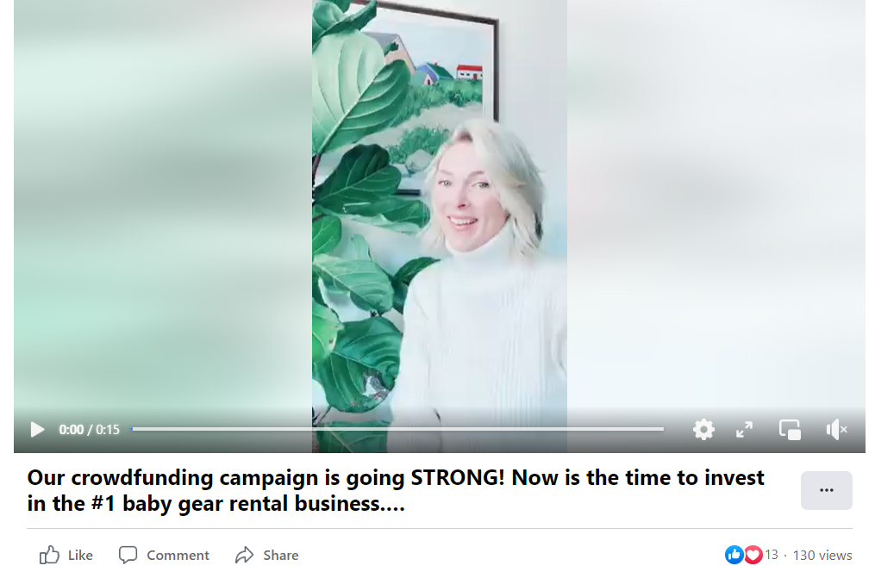
BabyQuip Case Study

Slide 25
Successful Crowdfunding: 7 Steps
Cost it out
Do your research: what differentiates successful & NOT?
Marketing: get your campaign covered!
Set fundraising goal
Figure out prizes & levels
Be sincere. Find your audience
Connect (get commitments b/f launch)
More than money – it’s about creating true fans & a market

Slide 26
Rules for Companies Raising Money
 | <100K | 100K-500K | >500K
Provide Financial Statements | ✔︎ | ✔ | ✔
Have Business Plan | ✔ | ✔ | ✔
Independent Accountants |  | ✔ | ✔
Audited Financials |  |  | ✔
Limited to $1 mil / 12 months | ✔ | ✔ | ✔

Slide 27
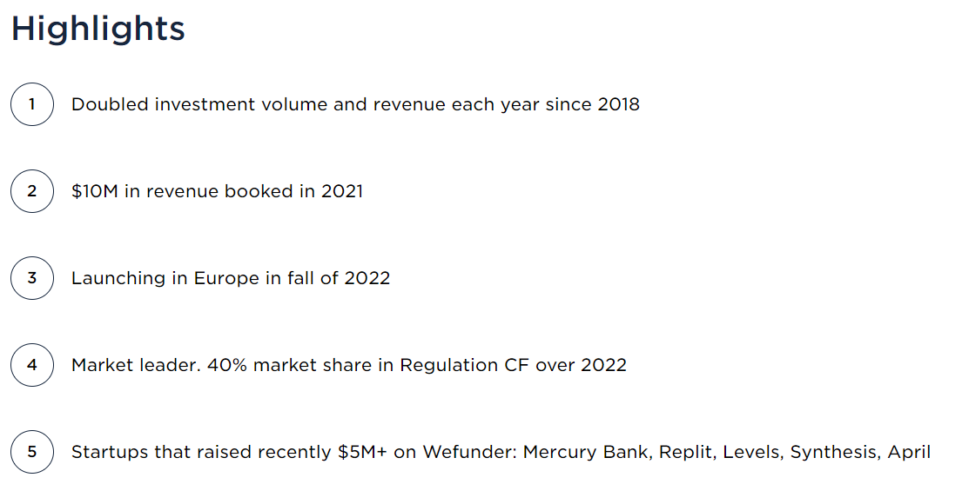
WeFunder

Slide 28
NM Angels & Crowdfunding
Collaborations with each of
WeFunder & StartEngine
Contact info@nmangels.com for Crowdfunding Referral Code
Learn more here

Slide 29
Thanks event sponsors & speakers!

Slide 30
Thank you for joining us
Make ABQ & NM HAPPEN!
www.nmangels.com
info@nmangels.com

