Slide 1
Quarterly Event in partnership with
NMSU Arrowhead Center
9.5.24

Slide 2
David Perez
Board Chair
Drew Tulchin
President

Slide 3
Thank you to event sponsor

Slide 4
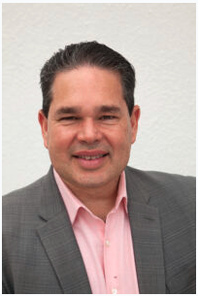
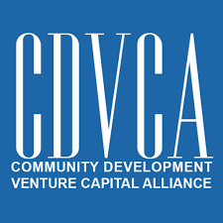
And Partners
Ernesto Villarini-Baquero

Slide 5
NM Angels - Mission
Support NM companies, New Mexican entrepreneurs and companies that make a difference for our people
Non-Profit Membership Org
(501c6, a la chamber of commerce) w/ 501c3 charity arm

Slide 6
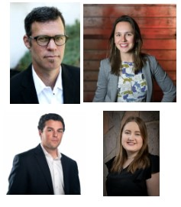
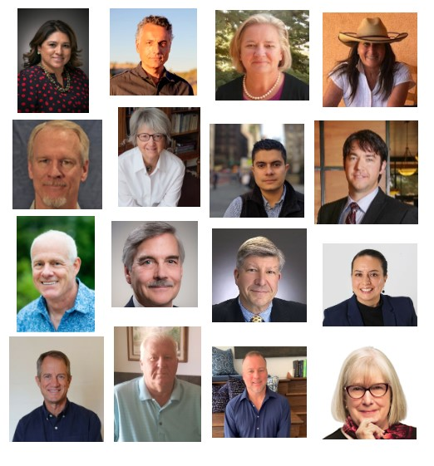
NM Angels - Who We Are
TEAM
BOARD

Slide 7
NM Angels - Who We Are
2024 Roster
Members | 172
Sponsors | 56
Partners | 5
Total | 233

Slide 8
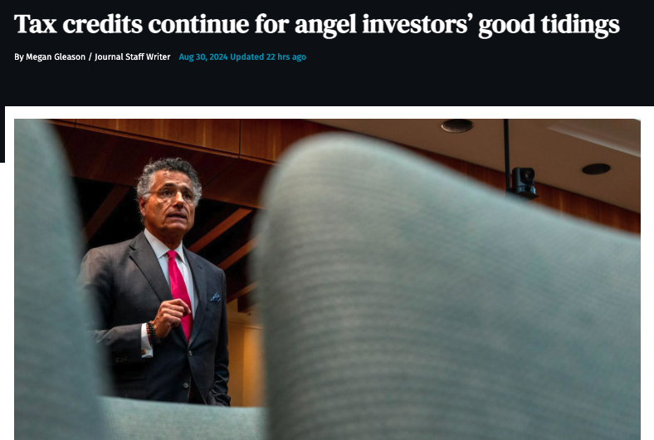
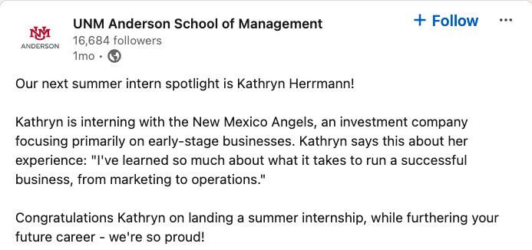
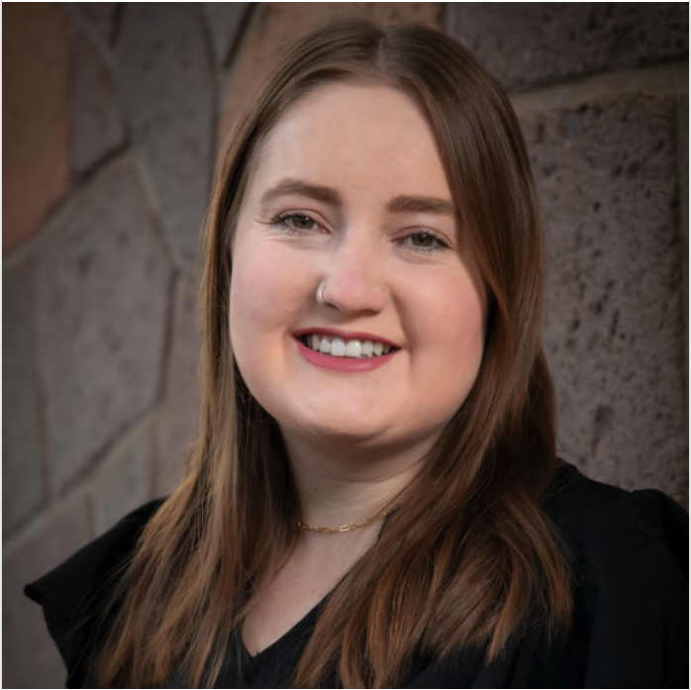
NM Angels: In the News
Albuquerque-based Nob Hill Therapeutics Raises $3M for Patented Pulmonary Technology

Slide 9
NM Angels 2024 YTD - Action
$1.5MM Invested in 13 companies by NM Angels, Members via NM Vintage Fund, Members directly
$1MM More Leveraged - syndication, connections
67+ Companies Assessed, Mentored
24 New Angels Trained

Slide 10
New Mexico Made
OVER $30 MILLION INVESTED SINCE 1999
Portfolio Companies Raising

Slide 11
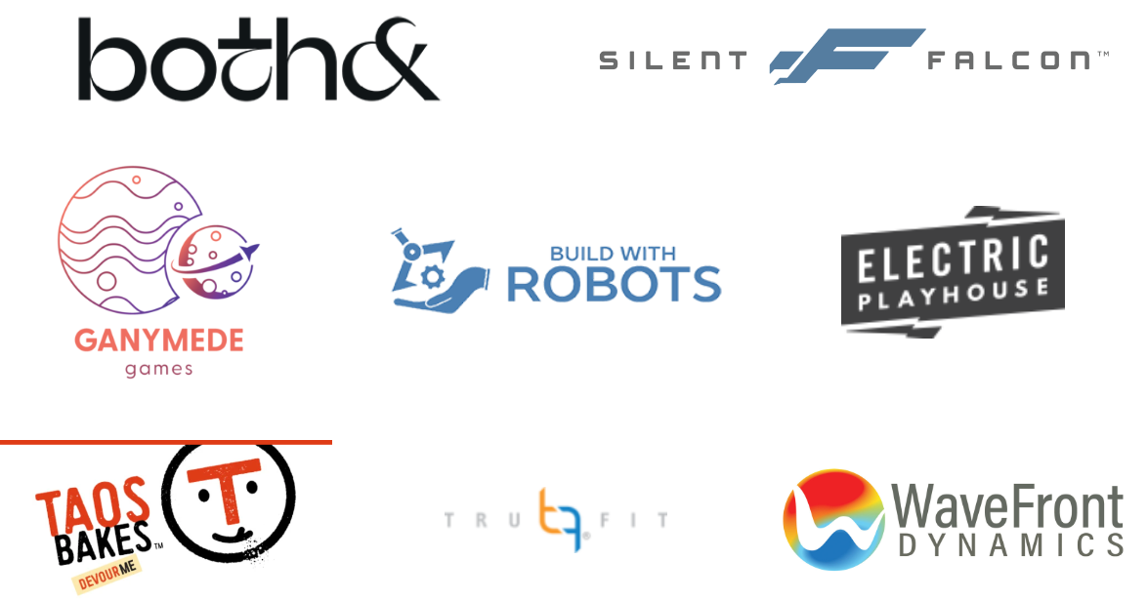
Portfolio Companies
Full Portfolio: https://nmangels.com/portfolio/

Slide 12
New Companies:
Relationship not Transaction
1. Introduce Yourself
Send solid intro email w/ presentation
Apply on Gust nmangels.com/applyforfunding/
2. Explore - “Time and Talent”
Quick Assessment - Written Feedback
Get to know us: Members, Sponsors, Partners
3. Build Value - “Treasure”
Pitch, Deep Dive, Due Diligence
Engage with seasoned entrepreneurs, investors in NM community

Slide 13
NM Vintage Fund
Purpose: Support local companies, NM founders & businesses making a difference in our state
Focus: Early-Stage / High Growth
Benefits investors & entrepreneurs
nmvintagefund.com

Slide 14
NM Vintage Fund in Operation
Funds I & II Closed
~$4MM, Investors ~90% NM residents
26 companies, 11 angel tax credits
Fund III (2024)
First Close was July 2024
$1+MM, 5 investments so far

Slide 15
2024 Done - Community
Programs
Partnered NMSU Arrowhead - Scale Up! Sprints
Mentor NMEDD & UNM Rainforest 2024 NM Research University Team Award Winners
Advisor for FedTech BOOST Program
Launched NM Angels Ambassador Program
Renewed NM Angel Tax Credit to 2030!
Events
Produced, partnered 60+ events ~4,000 participants
Notes:
Tatianna present
Operations - leveraging existing software launch of 2023 - using asana with enhanced features and efficiency. Further refine SOPs, roles and execution. Event programming in better alignment with our organizational goals - targeted collaborations with our premier & title sponsors, enhanced educational programming (frankie to talk more about this)
Mentorship program - Minimum - launch 2.0 - opening up the mentee pool to companies earlier in our Gust application pipeline, pre active deal. We’d like to see our mentor pool double as well as our mentees that we match. David will talk about this and some longer term strategic intiatives we are excited to start working on in 2024 - data hub project & mentorship sponsorship by NMEDD
Partnerships - execute on 2 x arrowhead and NM bio - learn from them. Seek out 1-2 additional opportunities for fractional cfo, consulting, advising roles with companies or organizations.
Referral programs - started in 2023 but want to really bring these to fruition - crowdfunding referrals (wefunder &
Member Sponsor - added value -
Onboarding - formalize the onboarding process so that members truly feel like they have a community and know how to navigate this as a resource. Ambassador program - part of enhancing our membership value and increasing our brand awareness and representation - aiming for at least 5-8 ambassadors throughout the year.
Angel Club - adding additional educational content like the self directed IRA
Member Onboarding
Member Director
Ambassador Program
New Angel Club
Fractional Execs “Club” pilot
Angel tax credit -

Slide 16
2024 To Do - Catalyze
Programs
Mentor Program 2.0
NM Vintage Fund III
Advance 3+ NM based companies
Activate Women Investors & Founders Group
Events
Next Quarterly - Santa Fe, Oct 23
Ambassadors
Education: Investors & Entrepreneurs
Support Others’ Gatherings!
Notes:
Tatianna present
Operations - leveraging existing software launch of 2023 - using asana with enhanced features and efficiency. Further refine SOPs, roles and execution. Event programming in better alignment with our organizational goals - targeted collaborations with our premier & title sponsors, enhanced educational programming (frankie to talk more about this)
Mentorship program - Minimum - launch 2.0 - opening up the mentee pool to companies earlier in our Gust application pipeline, pre active deal. We’d like to see our mentor pool double as well as our mentees that we match. David will talk about this and some longer term strategic intiatives we are excited to start working on in 2024 - data hub project & mentorship sponsorship by NMEDD
Partnerships - execute on 2 x arrowhead and NM bio - learn from them. Seek out 1-2 additional opportunities for fractional cfo, consulting, advising roles with companies or organizations.
Referral programs - started in 2023 but want to really bring these to fruition - crowdfunding referrals (wefunder &
Member Sponsor - added value -
Onboarding - formalize the onboarding process so that members truly feel like they have a community and know how to navigate this as a resource. Ambassador program - part of enhancing our membership value and increasing our brand awareness and representation - aiming for at least 5-8 ambassadors throughout the year.
Angel Club - adding additional educational content like the self directed IRA
Member Onboarding
Member Director
Ambassador Program
New Angel Club
Fractional Execs “Club” pilot
Angel tax credit -

Slide 17
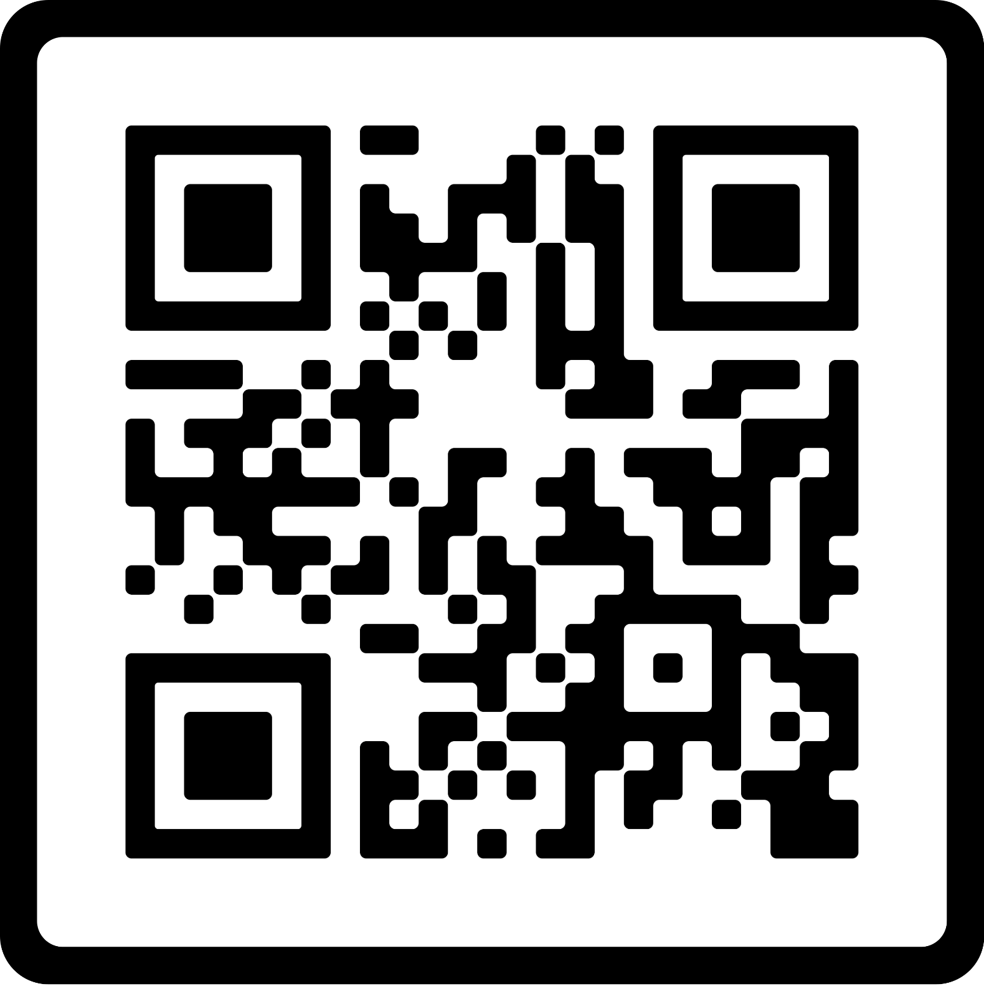
Mentoring
Mentor Program 2.0 this fall!
All Portfolio Companies, Active Prospects, Partners’ Companies’ can apply via info@nmangels.com
Notes:
Drew to mention companies, mentors and who we’ve partnered with, the program is advancing.
Stock photo. Smile for the camera and thanks to our photographer

Slide 18
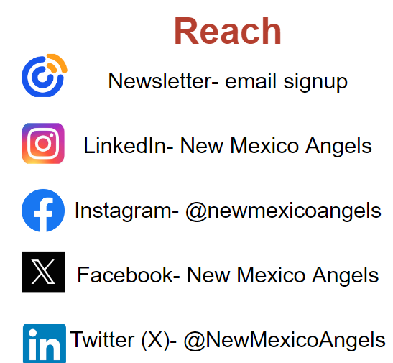
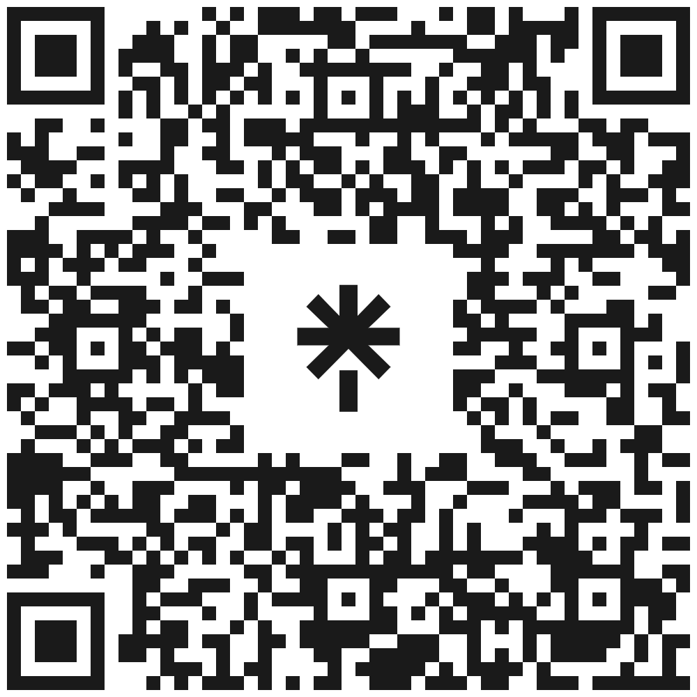
Connect!
Social Media
Sign up here!

Slide 19
Become an Angel!
Membership
Sponsorship
NM Angels events & programs (in-person and online)
1:1 Connecting to Community of NM Angel Members / Sponsors
Education
Access national ACA
Position your biz as leading investment partner in NM
Promotion on NM Angels’ website, e-news, at events
Reach our community / Referrals
Early access to current deals

Slide 20
Thanks Recent & Renewing Sponsors!

Slide 21
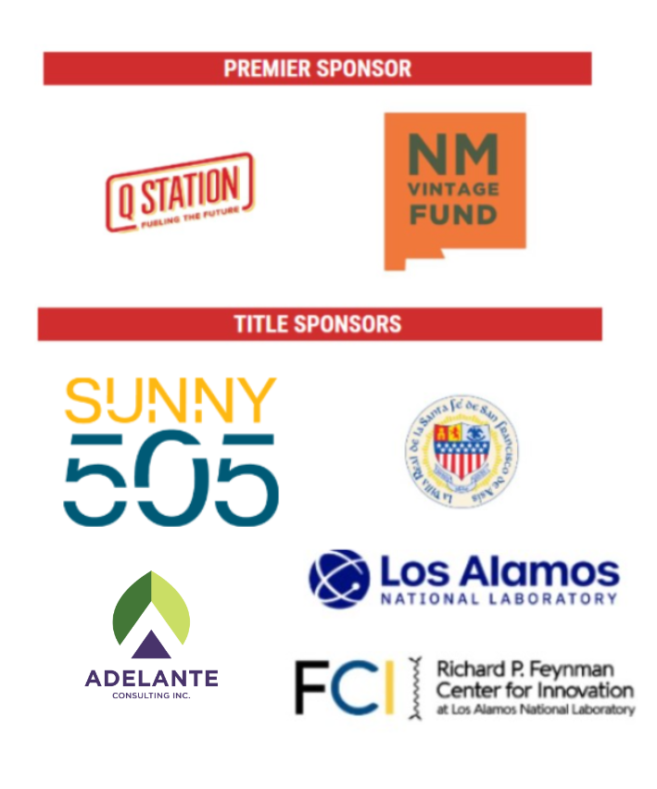

Slide 22
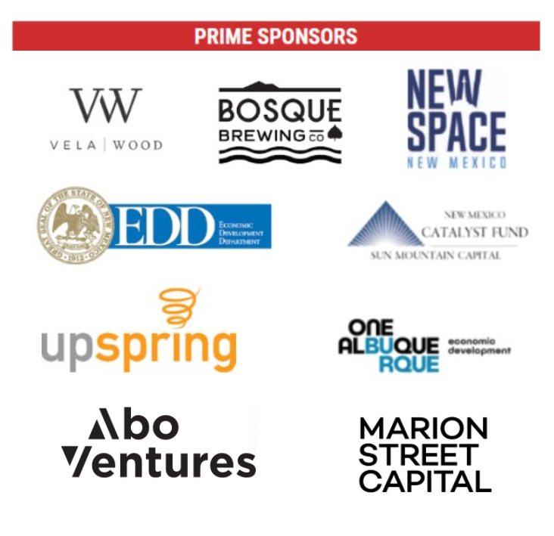

Slide 23
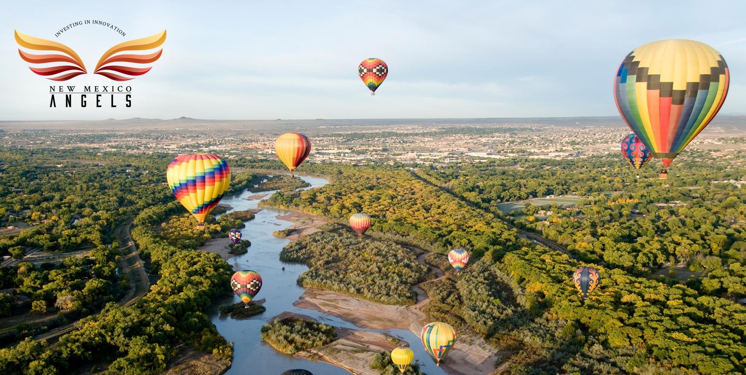
Thank you
Entrepreneurs
in the room!
You make this possible!

Slide 24
Coming Up - See You Soon
Startup Fiesta @ New Mexico Tech Summit
TUES, Sept 10 - ABQ
5-7:30PM
NM Angels Screening Committee
TUES, Sept 24 - Virtual / Monthly
4-5:20PM
NM Angels Next Quarterly
WED, Oct 23 - Santa Fe
5-7:30PM
Show Her the Money Movie and Discussion
TUES, Oct 29 - Santa Fe
5-8PM

Slide 25
Deep Dives
Lithium-sulfur hybrid flow battery
Eye measuring device improving eye care
Water purification & desalination
Members & Sponsors
Hybrid (ABQ, Zoom) // FRI Sept 6, 10a-12p
Contact Staff, info@nmangels.com

Slide 26
Thank you for joining us
Help Make NM HAPPEN!
www.nmangels.com
info@nmangels.com

Slide 27
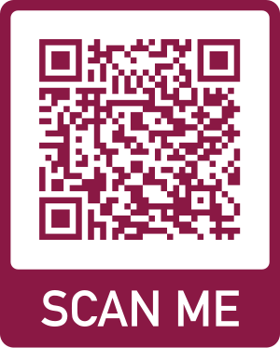
Arrowhead Center

Slide 28
Winner Announcement

